Slide 1
Small Scale Fading

Slide 2
Small Scale Fading/ Fading
The rapid fluctuations of received signal strength over short time intervals or travel distances.
Caused by interference from multiple copies of Tx signal arriving at Rx at slightly different times.
Three most important effects:
Rapid changes in signal strengths over small travel distances or short time periods.
Random frequency modulation due to varying Doppler shifts on different multipath signals
Time dispersion (echoes) caused by multipath propagation delays.
Notes:
Small scale fading or simply fading. Signal strength = amplitude
2. Changes in the frequency of signals.
3. Multiple signals arriving a different times. When added together at the antenna, signals are spread out in time. This can cause a interference between bits that are received.

Slide 3
Factors Influencing Small-Scale Fading
1) Multipath Propagation
The presence of reflecting objects and scatterers in the space between transmitter and receiver creates a constantly changing channel environment
Causes the signal at receiver to fade or distort
2) Speed of Mobile
Relative motion between base station and mobile causes random frequency modulation due to Doppler shift (f_{d})
Different multipath components may have different frequency shifts.
Notes:
Relative motion is the calculation of the motion of an object with regard to some other moving object.

Slide 4
Factors Influencing Small-Scale Fading
3) Speed of Surrounding Objects
If the speed of surrounding objects is greater than mobile, the fading is dominated by those objects
If the surrounding objects are slower than the mobile, then their effect can be ignored
4) The transmission bandwidth of the signal
Depending on the relation between the signal bandwidth and the coherence bandwidth of the channel, the signal is either distorted or faded
If the signal bandwidth is greater than coherence bandwidth it creates distortion
If the signal bandwidth is smaller than coherence bandwidth it create small scale fading
Notes:
the bandwidth of the channel can be quantified by the coherence bandwidth which is related to the specific multipath structure of the channel. The coherence bandwidth is a measure of the maximum frequency difference for which signals are still strongly correlated in amplitude.

Slide 5
Doppler Effect/Shift
When a transmitter or receiver is moving, the frequency of the received signal changes. It is different than the frequency of transmission. This is called Doppler Effect.
The change in frequency is called Doppler shift
The Doppler shift is positive
If the mobile is moving towards the direction of arrival of the signal.
The Doppler shift is negative
If the mobile is moving away from the direction of arrival of the signal.
Notes:
See 20121212.. Pdf

Slide 6
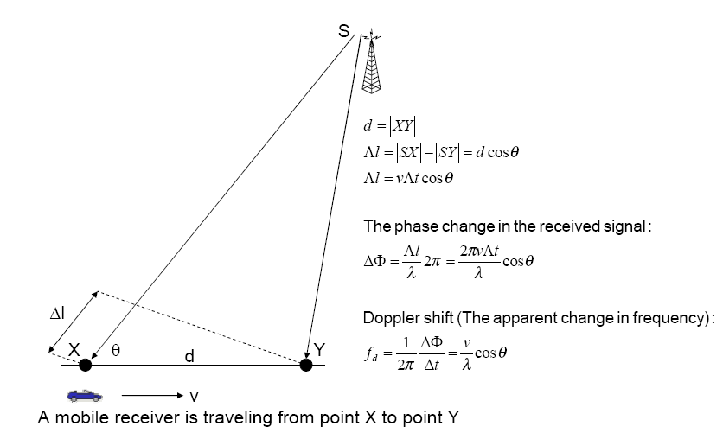
Doppler Shift – Receiver is moving
Notes:
Apparent = actual

Slide 7
Example – 4.3:
Consider a transmitter which radiates a sinusoidal carrier frequency of 1850 MHz. For a vehicle moving 60 mph, compute the received carrier frequency if the mobile is moving
(a) directly towards the transmitter,
(b) directly away from the transmitter,
(c) in a direction which is perpendicular to the direction of arrival of the transmitted signal.
Notes:
1 mile = 1609.344m
60 mile = 96560.64m/hr = 26.8224m/sec
1 hr = 60x60 sec

Slide 8

Impulse response of Multipath channel
The small scale variations of a mobile radio signal can be directly related to the impulse response of mobile radio channel.
Impulse response contains all information necessary to
Simulate the channel
Analyze the channel
A mobile radio channel may be modeled as a linear filter with a time varying impulse response
Notes:
It is the response(output) from a system (or process) when you put an 'impulse (unit pulse, delta function)' as an input. It is because it fully characterize a system. If you know the impulse response of a system, you can figure out the response (output) of the system for any kind of input without even testing it.
Casual system : https://books.google.com.bd/books?id=ZZeYb-GASbMC&pg=SA2-PA51&dq=Impulse+Response+Model+of+a+Multipath+Channel&hl=en&sa=X&ved=0ahUKEwiV36qsn77hAhUp8HMBHUHgDoUQ6AEIOTAD#v=onepage&q=Impulse%20Response%20Model%20of%20a%20Multipath%20Channel&f=false

Slide 9
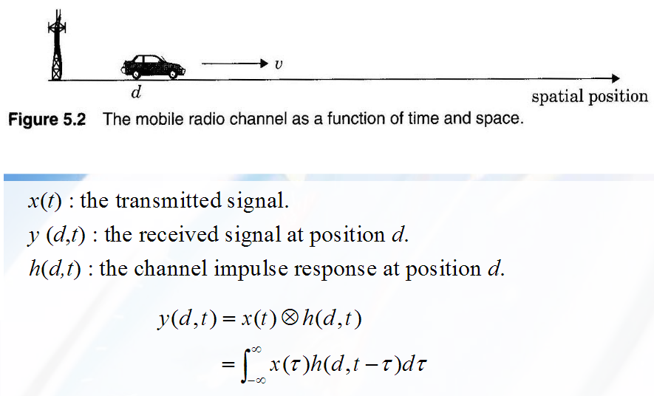
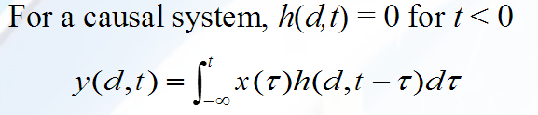
Impulse Response Model:

Slide 10
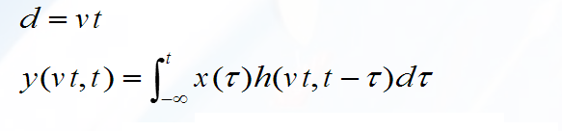

Since the receiver moves along the ground at a constant velocity v, the position of the receiver can by expressed as
Since v is a constant, y(vt, t) is just a function of t. Therefore,
From equation, it is clear that the mobile radio channel can be modeled as a linear time varying channel, where the channel changes with time and distance.

Slide 11
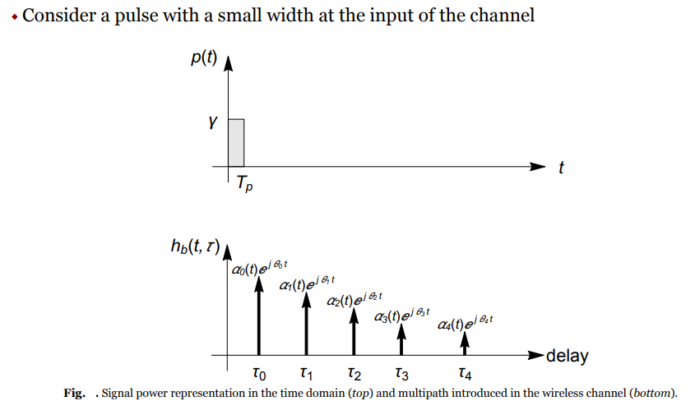

Slide 12
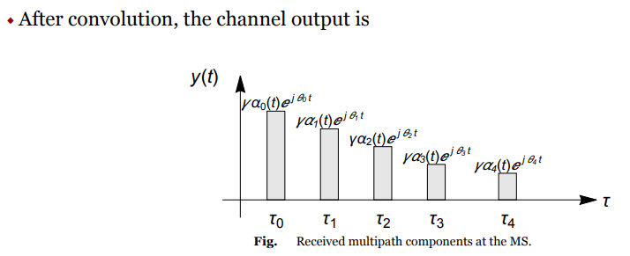

Slide 13
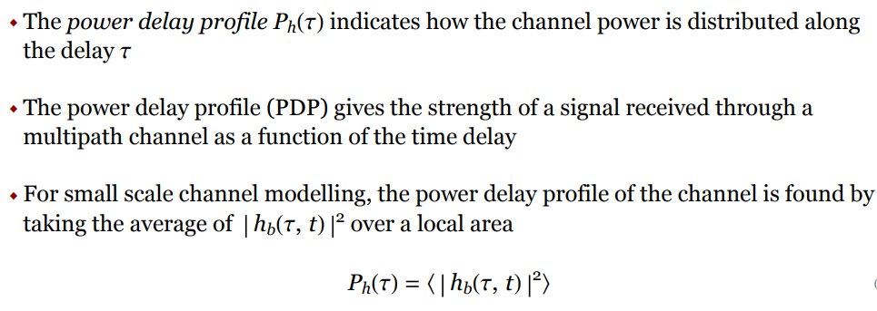
Power Delay Profile

Slide 14
Time Dispersion Parameters
The time dispersion parameters that can be determined from a power delay profile are
mean excess delay
rms delay spread
excess delay spread
To quantify “how spread-out” the arriving signals are, we use time dispersion parameters
Notes:
Dispersion = spreading

Slide 15
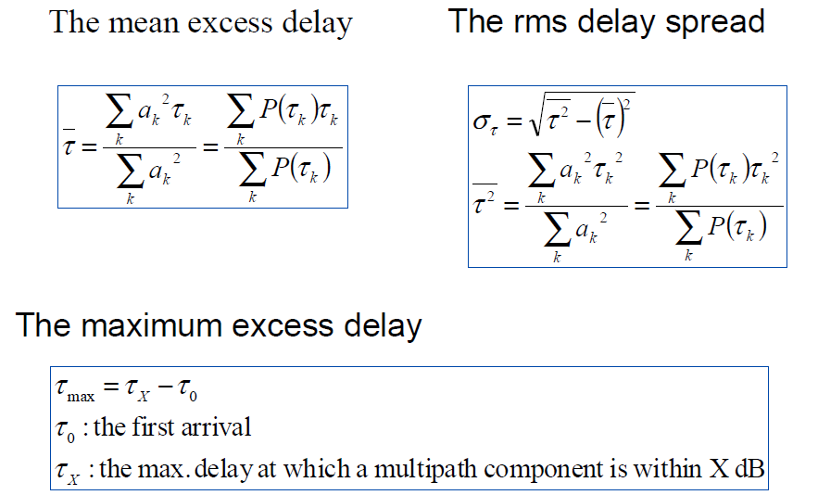
Time Dispersion Parameters
Notes:
Dispersion = spreading
the second moment of the mean excess delay

Slide 16
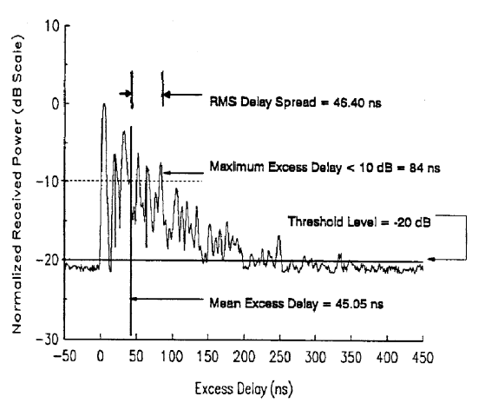
Time Dispersion Parameters: Max Excess Delay(X dB)
Notes:
Dispersion = spreading
the second moment of the mean excess delay

Slide 17
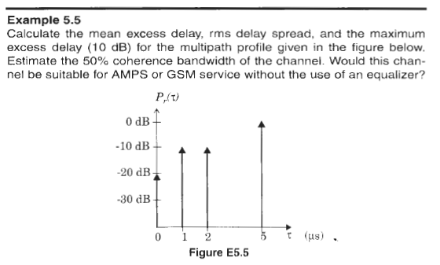
Notes:
Dispersion = spreading
the second moment of the mean excess delay

Slide 18
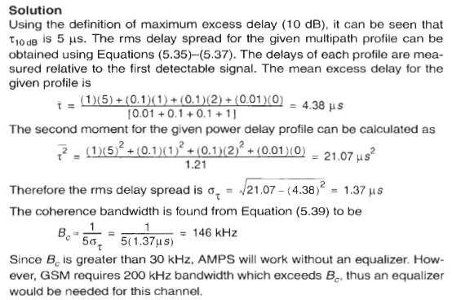
Notes:
Dispersion = spreading
the second moment of the mean excess delay

Slide 19
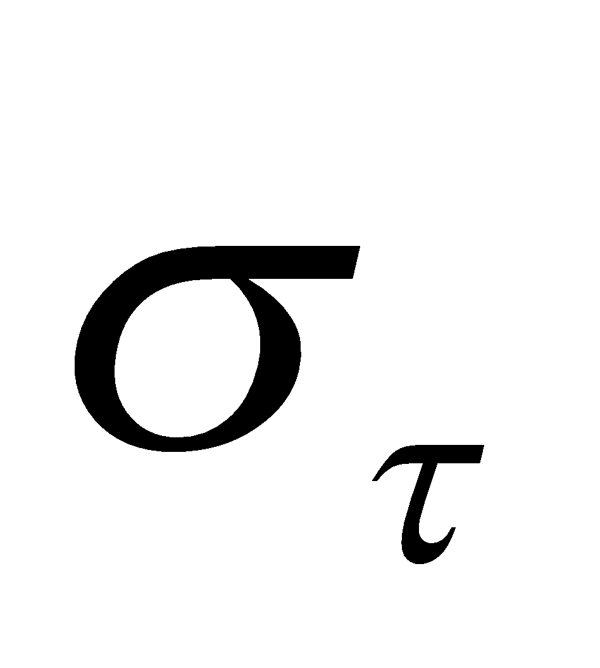
Coherence Bandwidth (B_{c})
B_{c} : statistical measure of frequency range where MRC response is flat
MRC response is flat = passes all frequencies with ≈ equal gain & linear phase
Amplitudes of different frequency components are correlated
If two sinusoids have frequency separation greater than B_{c}, they are affected quite differently by the channel
Estimates coherence BW (B_{c} )
0.9 correlation → B_{c} ≈ 1 / 50 (signals are above 90% correlated with each other)
0.5 correlation → B_{c} ≈ 1 / 5 (signals are above 50% correlated with each other)
Notes:
Dispersion = spreading
the second moment of the mean excess delay

Slide 20
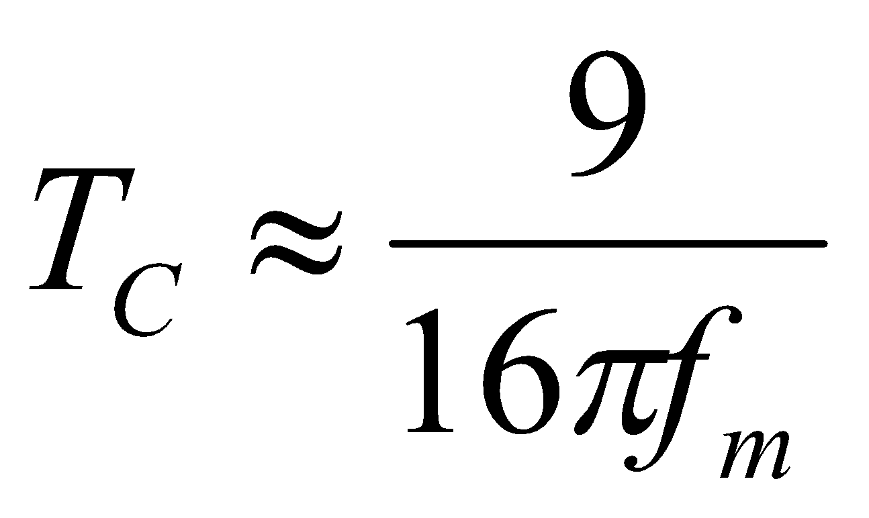
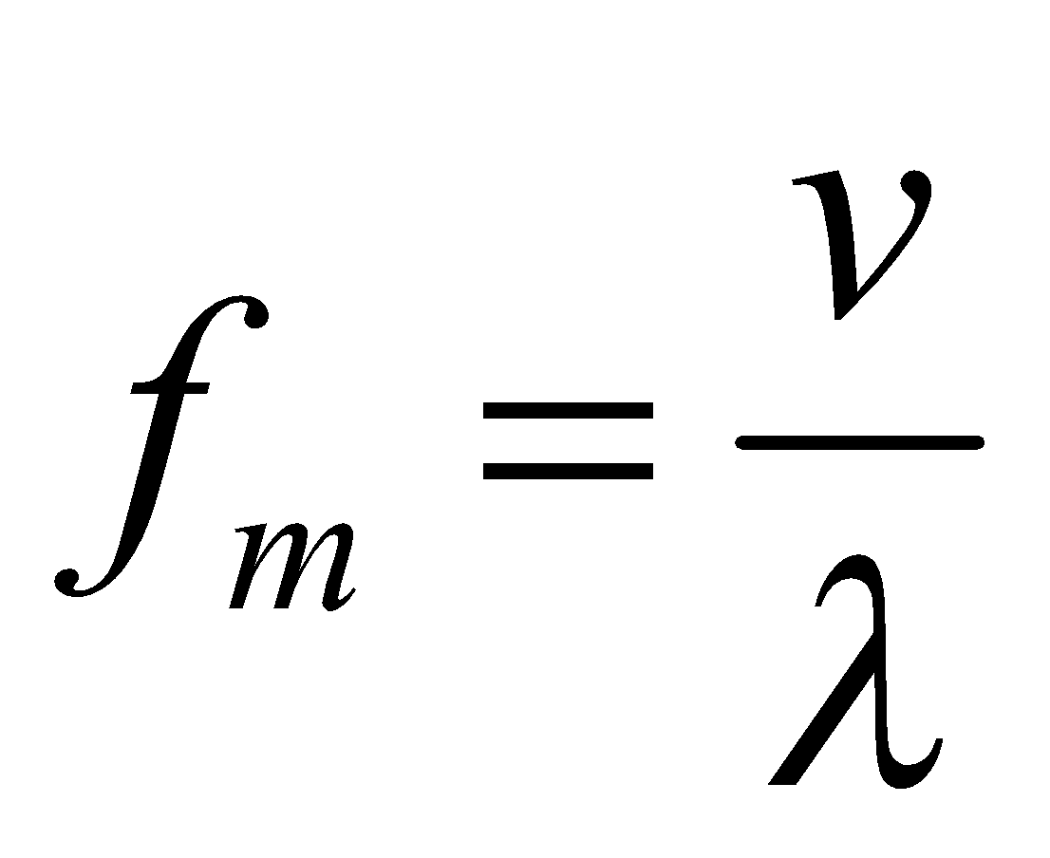
Coherence Time (T_{c})
Coherence time is the time duration over which the channel impulse response is essentially invariant.
If the symbol period of the baseband signal is greater the coherence time, than the signal will distort.
Coherence time is also defined as:
T_{S}
where f_{m} is the maximum Doppler spread given by
T_{C}
Notes:
See 20121212.. Pdf

Slide 21
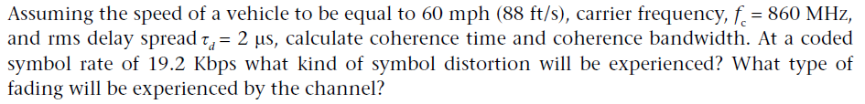
Example
Notes:
V = 88 ft/s
Tc = 9/16pifm = 9/16x3.14x77 = 2.3 ms
Fm = v/lemda = 88/1.142 = 77 Hz
Lemda = c / f =9.8 x 10^8/ 860 x 10^6 = 1.1442 ft
Ts = 10^6/19200 = 5.2 micro s

Slide 22
Doppler Spread (B_{D})
Measure of spectral broadening caused by motion
We know how to compute Doppler shift: f_{d}
Doppler spread, B_{D}, is defined as the maximum Doppler shift: f_{m} = v/λ
If the baseband signal bandwidth is much greater than B_{D} then effect of Doppler spread is negligible at the receiver.
Notes:
See 20121212.. Pdf

Slide 23
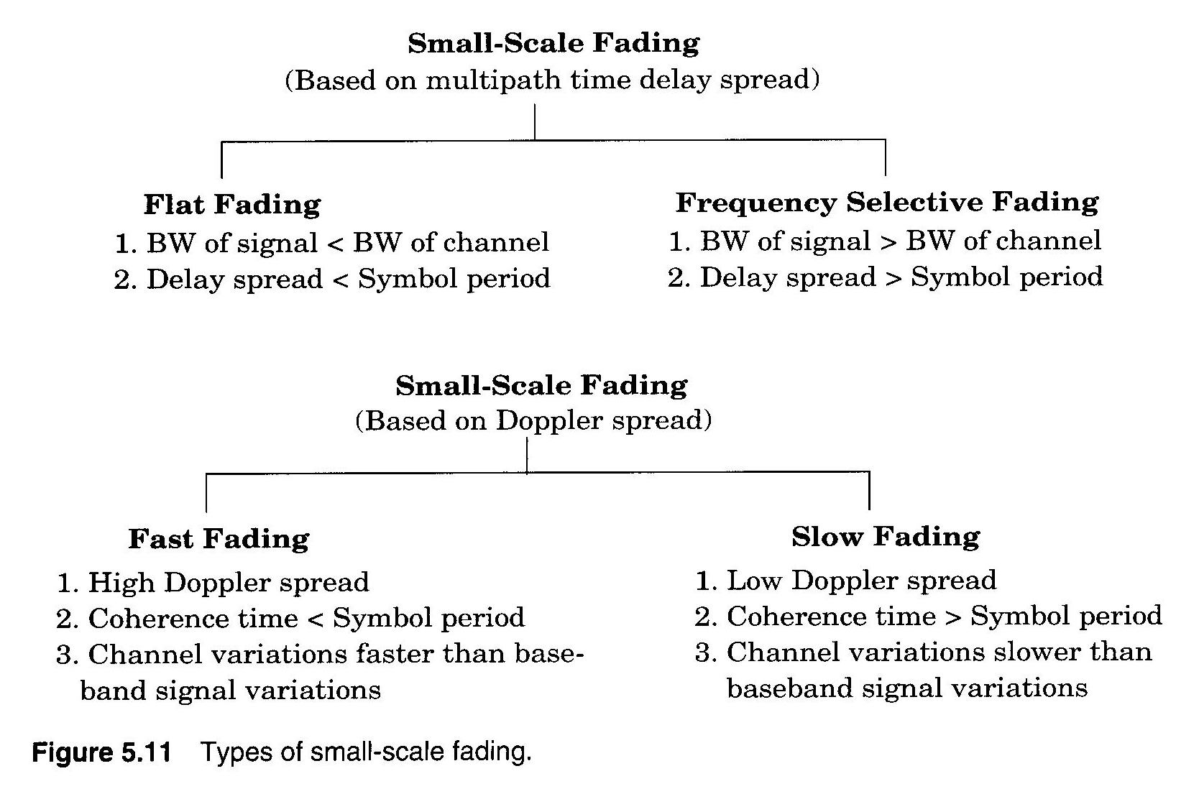
Types of small-scale fading

Slide 24
Flat Fading
Occurs when symbol period of the transmitted signal is much larger than the Delay Spread of the channel
Bandwidth of the applied signal is narrow.
If B_{s} << B_{c} , and T_{s} >> σ_{τ} ⇒ Flat fading
Flat fading channels are known as amplitude varying channels or narrow-band channels.
A rule of thumb that channel is assumed to be flat fading if T_{s} > 10σ_{τ}
All frequencies undergone the same amount of fading
Notes:
24

Slide 25
Frequency Selective Fading
Occurs when channel multipath delay spread is greater than the symbol period.
If B_{s} >> B_{c} , and T_{s} << σ_{τ} ⇒ Frequency selective fading
Channel induces Intersymbol Interference (ISI)
Frequency selective fading channels are known as wideband channels since the BW of the signal is wider than the BW of the channel impulse response.
A rule of thumb that channel is assumed to be frequency selective fading if T_{s} <= 10σ_{τ}
Not all frequencies undergone the same amount of fading.
Notes:
25

Slide 26
Example (1)
Calculate the total excess delay, mean delay and RMS delay spread for a channel whose PDP is specified as follows:
Relative delay [μsec] | Average relative power [dB]
0.0 | -3.0
0.2 | 0.0
0.5 | -2.0
1.6 | -6.0
2.3 | -8.0
5.0 | -10.0
Total excess delay is simply the difference between the shortest and longest delays: 5 μsec
The mean delay is found by multiplying the powers by the delays and summing:
τ_{o}= 1/2.64 × {(0.5×0) + (1×0.2) + (0.63×0.5) + (0.25×1.6) + (0.16×2.3) + (0.10×5)}
= 0.678 μsec

Slide 27
Example (2)
To find the RMS delays spread, the average power is normalized as follows:
Average relative power [dB] | Average relative power [W] | Average relative power (normalised)
-3.0 | 0.50 | 0.19
0.0 | 1.00 | 0.38
-2.0 | 0.63 | 0.24
-6.0 | 0.25 | 0.09
-8.0 | 0.16 | 0.06
-10.0 | 0.10 | 0.04
The RMS delay spread can be found as:
τ²_{RMS}= (0.19×0²) + (0.38×0.2²) + (0.24×0.5²) + (0.09×1.6²) + (0.06×2.3²) + (0.04×5²) – (0.678²)
= 1.163 (μsec²)
This is still correct because τ_{i}² above is expressed in squared of micro-second .(μsec²). By performing square-root onto (μsec²) gives us back (μsec) in unit. (think about it!)
Hence, τ_{RMS} = 1.08 μsec

Slide 28
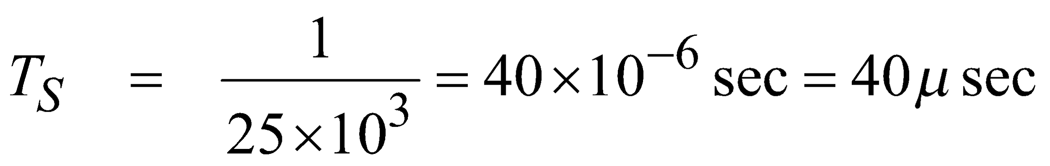
Example
From the previous calculation of PDP, would the channel be regarded as a wideband channel for a binary data system with data rate of 25 Kbits/sec?
If the data rate is 25 × 10³ bits/sec, then the symbol period T_{S} is:
It is found previously that τ_{RMS} = 1.08 μsec, so rule of thumb 10×τ_{RMS} ≈ 10 μsec
Hence, the channel can regards as narrowband flat fading since T_{S} >> 10τ_{RMS}
What is the maximum data rate for the system to be ISI-free? (For ISI-free, T_{S} >10τ_{RMS} condition must be fulfilled)
Since 10τ_{RMS} is about 10 μsec, then the minimum symbol period T_{S} must not be less than 10 μsec. Therefore, we can write that T_{S} = 10 μsec
Hence, the maximum data rate is: 1/T_{S} = 1/(10×10⁻⁶) = 100Kbits/sec, for ISI-free system

Slide 29
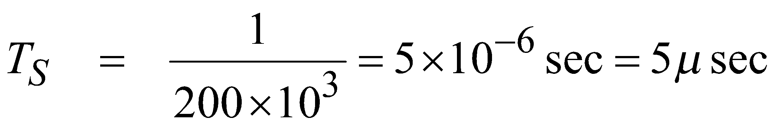
Example
Can the channel considered as narrowband when the data rate in the previous example is increased to 200Kbits/sec?
If the data rate is 200 × 10³ bits/sec, then the symbol period T_{S} is:
We know from previously that 10×τ_{RMS} ≈ 10 μsec which is greater than T_{S}
Therefore, the channel can no longer considered as narrowband since T_{S} < 10τ_{RMS} . Hence, a wideband frequency selective fading channel.

Slide 30
Fast Fading
Due to Doppler Spread
Rate of change of the channel characteristics is larger than the Rate of change of the transmitted signal
The channel changes during a symbol period.
The channel changes because of receiver motion.
Coherence time of the channel is smaller than
the symbol period of the transmitter signal
It causes frequency dispersion due to Doppler spread and leads to distortion.
Occurs when:
B_{S} < B_{D}
and
T_{S} > T_{C}
Notes:
30

Slide 31
Slow Fading
Due to Doppler Spread
Rate of change of the channel characteristics is much smaller than the rate of change of the transmitted signal
Occurs when:
B_{S} >> B_{D}
and
T_{S} << T_{C}
B_{S}: Bandwidth of the signal B_{D}: Doppler Spread
T_{S}: Symbol Period T_{C}: Coherence Bandwidth
Notes:
31

Slide 32
Summary of Channel Classification
1) Frequency Flat (no delay-spread) & Time-Flat (slow fading) Channel
B_{S} << B_{C} T_{S} << T_{C}
or or
T_{S} >> τ_{rms} B_{S} >> B_{D}
(Doubly –flat fading channel)
2) Frequency Flat (no delay-spread) & Time-Selective (fast fading) Channel
B_{S} << B_{C} T_{S} > T_{C}
or or
T_{S} >> τ_{rms} B_{S} < B_{D}
(Fast-varying flat fading channel)
3) Frequency Selective (Delay-spread) & Time-Flat (slow fading) Channel
B_{S} > B_{C} T_{S} << T_{C}
or or
T_{S} < τ_{rms} B_{S} >> B_{D}
(Slow-varying frequency selective channel)
4) Frequency Selective (Delay-spread) & Time-Selective (fast fading) Channel
B_{S} > B_{C} T_{S} > T_{C}
or or
T_{S} < τ_{rms} B_{S} < B_{D}
(Doubly dispersive fading channel)
B_{S} = Bandwidth of the baseband signal T_{S} = Symbol duration of the baseband signal
B_{C} = Coherence bandwidth of the channel T_{C} = Coherence time of the channel
B_{D} = Doppler spread of the channel τ_{rms} = RMS delay spread of the channel

Slide 33
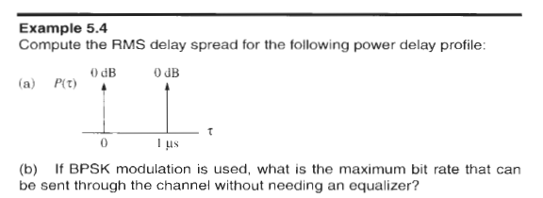
Example
Notes:
See 20121212.. Pdf

Slide 34
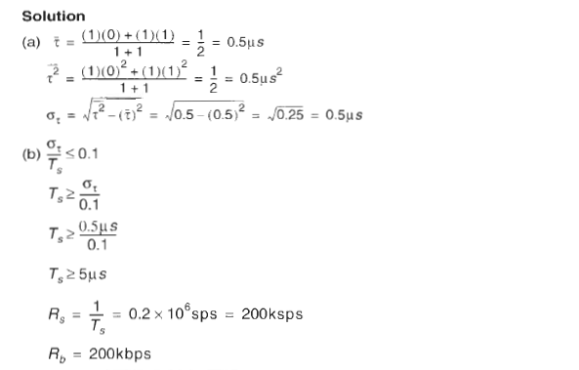
Example

